Slide 1


A Survey of Large Language Models
This presentation is a summary and review of the article: “A Survey of Large Language Models”
Presented by Nick Kornienko

Slide 2

Introduction to LLMs
Why are LLMs and language important?
  Limitations of traditional machines and programs
  Importance of understanding human language in AI
  Versatility of language models
What do modern LLMs look like and do?
  Transformer architecture
  OpenAI, GPT, Llama
  Generative AI

Slide 3
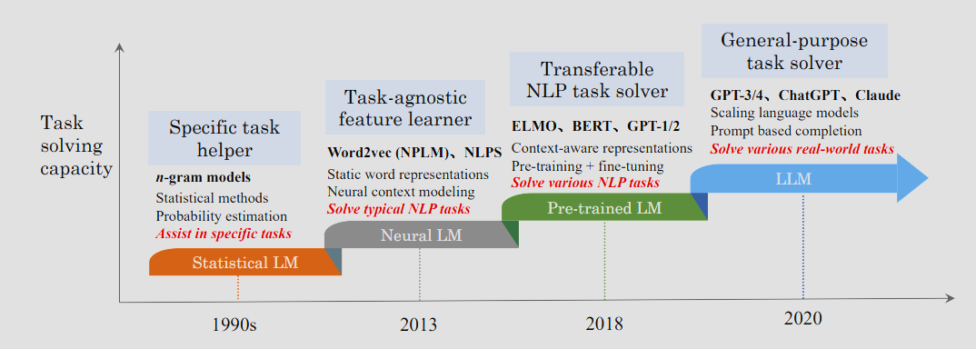
The history evolution of language models
Early statistical models
  Introduced in the 1990s
  Markov probability and chains
  Very limited, exponential complexity increase
Neural networks and transformer architecture
  Neural networks
  Transformers
Modern LLMs
  BERT, GPT, Llama
  Primarily built on transformer architecture
  Billions-Trillions of parameters

Slide 4

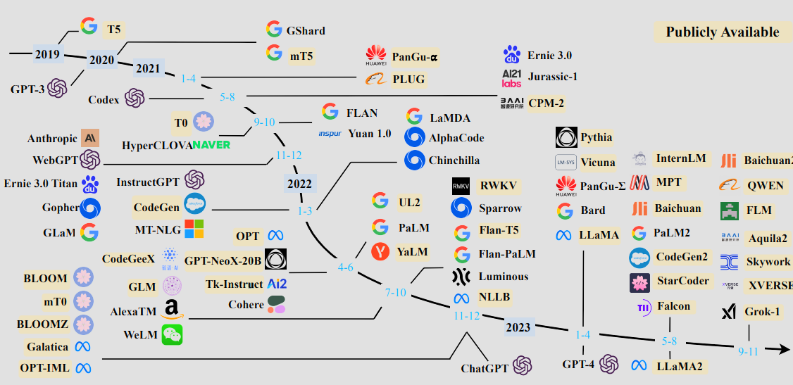



The Era of Large Language Models (LLMs)
Modern LLMs
  BERT, GPT, Llama
  Focus on generative AI
Billions of parameters
  Small models range from 2-70b parameters
  Large models have 1T+ (GPT-4)
High accuracy, but not perfect
  Hallucinations
  False results

Slide 5

Real-World Applications and Impact
Code generation
  Analyzing existing code
  Transform high level concepts into code
  Sped up monotonous tasks
Education
  Increase access and availability of information
Text generation
  Generate natural language text
Image generation
  DALL E, Gemini, Midjourney

Slide 6

Challenges and Ethical Considerations
High cost and environmental impact
  Larger models take up many resecures
Wide-spread misinformation
  Fake articles generated quickly
  Deep-fake images and videos
Intellectual property theft
  AI can unintentionally violate copyright law
  Data scraping without consent

Slide 7

The Future of LLMs
Higher quality models
  Better results, more parameters, fewer mistakes
Improved efficiency
  Recreating the same results as large models with fewer parameters
Ethical considerations
  Ensuring equal access and availability
  Preventing harmful content

